Slide 1

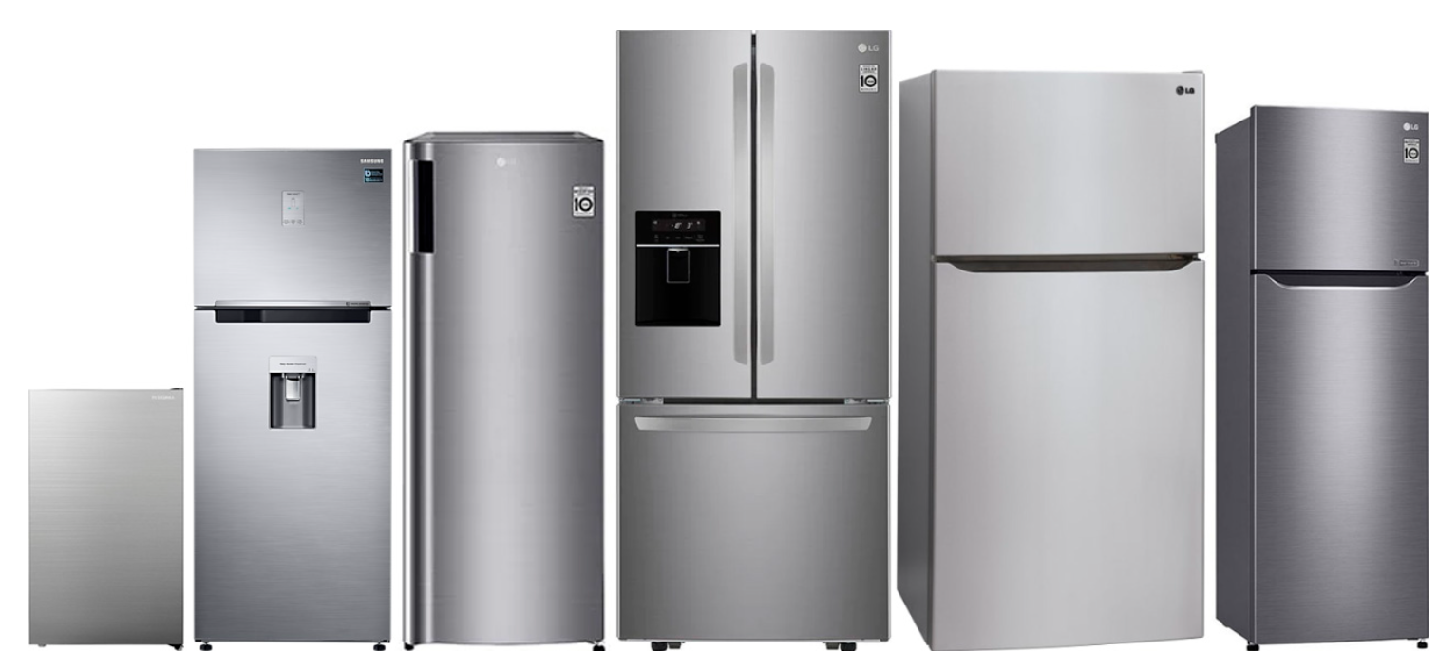
"Web Scraping Flipkart: Analyzing Refrigerator Trends & Insights"

Slide 2
Purpose:
Why you want to learn Data Science
After completing my BSc in Mathematics , I am in search of fields in which i can make my career and after my long search i got to know about data science when i searched about it more i found that it involves statistics along with technology to gain insights from the data and help to solve the business problems so after knowing all the things about data science i found it the best fit for me . so i choose data science as my career option .

Slide 3
Problem Statement:
To analyze the impact of refrigerator features and energy efficiency on its price and number of rating
. Objective of the Project
The objective of this project is to extract and analyze the refrigerators data from flipkart using web scraping.The goal is to gather insights on refrigerators pricing , features , brand and customer rating to understand market trends and how features and energy ratings impacts price.

Slide 4
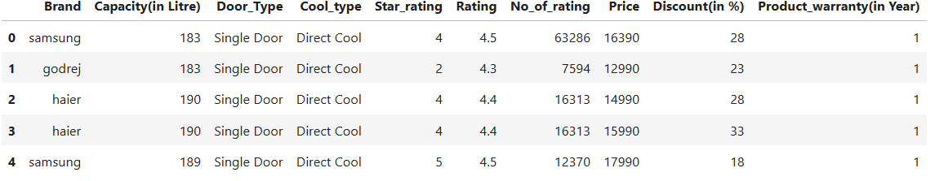
Other columns except from the above summary are:
1.Digital Inverter→ This column shows whether the respective refrigerator has the digital inverter technology or not.
2.No_of_review→ This column shows the number of reviews for the respective refrigerator.
3.Compressor_type→ This column shows different types of compressor for the respective refrigerator.
4.Built-in-Stabilizer→ This column shows whether the refrigerator have built-in-stabilizer or not.
5.Compressor_warranty(in Year)--> This columns the warranty period for the compressor of respective refrigerators.
6.Original_price→ This column shows the prices of the respective refrigerators without discount.

Slide 5
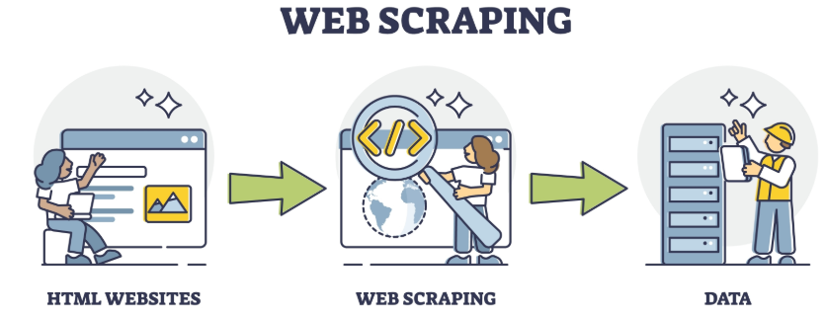
Web Scraping – Details (Websites, Processor you followed)
Website-> Flipkart(www.flipkart.com) extracted the refrigerator data.
. Process followed for web scraping
1. Identifying target column-> select relevant product categories such as brand,price,capacity(in L) ,star_rating etc
2.Inspecting website structure-> right click and open inspect column to get html tags for required data
3.Used Python libraries-> The libraries used for web scraping are
.requests -> To send http requests
.BeautifulSoup -> To parse the html content
.Pandas -> To store the scraped data in dataframe
.Matplotlib -> It is used for data visualization
.Seaborn-> It is also used for data visualization

Slide 6
Data cleaning:
1.Handling missing values
2.Fix data types
3.Handling outliers
4.changing all text data in lower format for brands
Data Manipulation Steps:
1.Derive new columns
2.Renaming the columns
Bivariate Analysis Steps:
(For Categorical vs Numerical)
1.Box plot-> To check distribution of numerical column based on categories
(For Numerical vs Numerical)
1.Scatter plot-> To identify relation between two numerical columns
2.Heatmap-> Showing the correlation on numerical columns
(For Categorical vs Categorical)
1.Grouped Bar Chart -> To check the count of the categorical columns.
Univariate Analysis Steps:
(For numerical columns):
1.Histogram-> To check distribution
2.Box plot-> To identify outliers
(For Categorical columns):
1.Barchart-> To check the count of categorical column

Slide 7
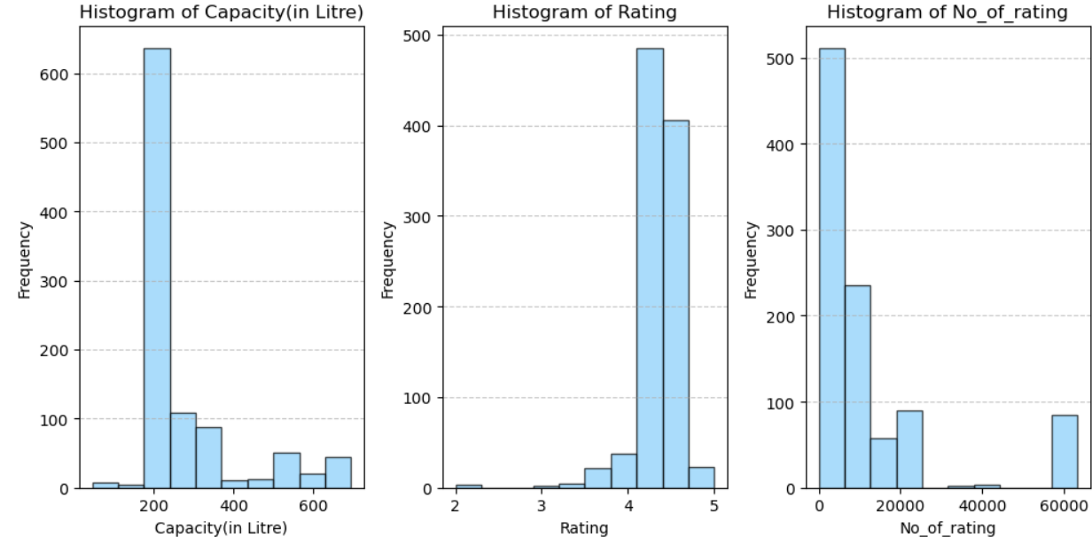
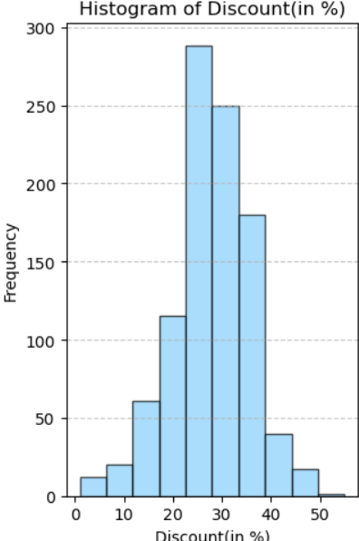
Univariate plot on all Numerical Columns

Slide 8
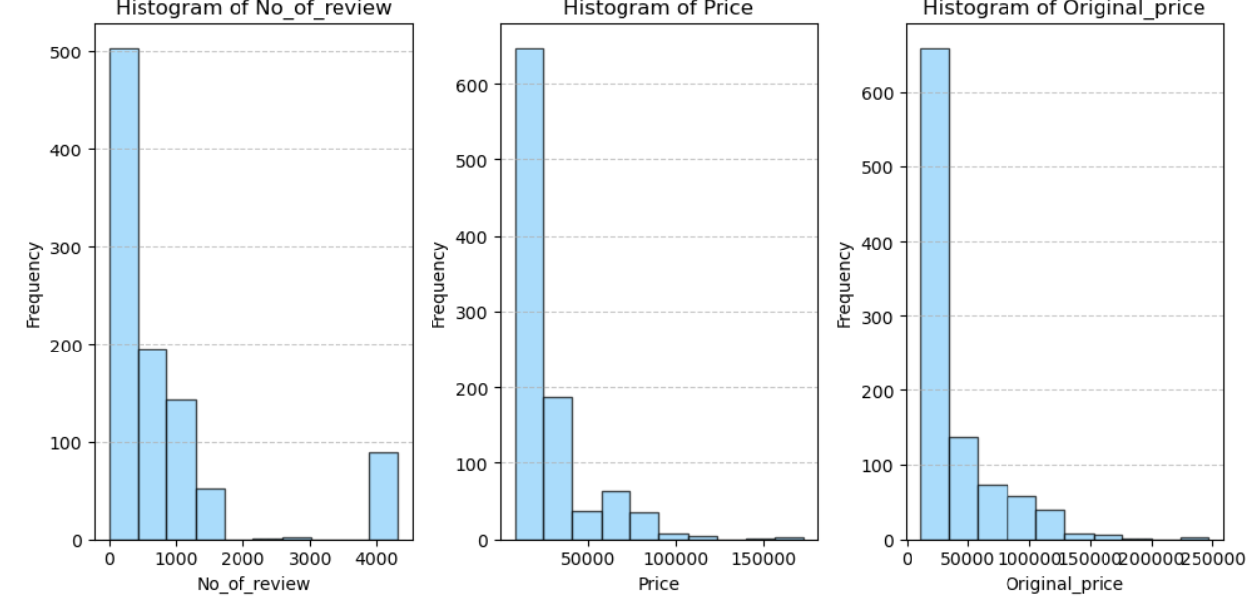
Observation-> All the above plots shows us the distribution of our data in the numerical columns

Slide 9
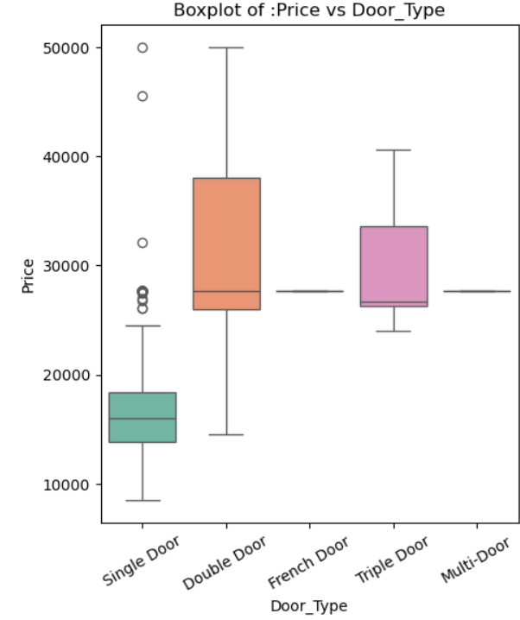
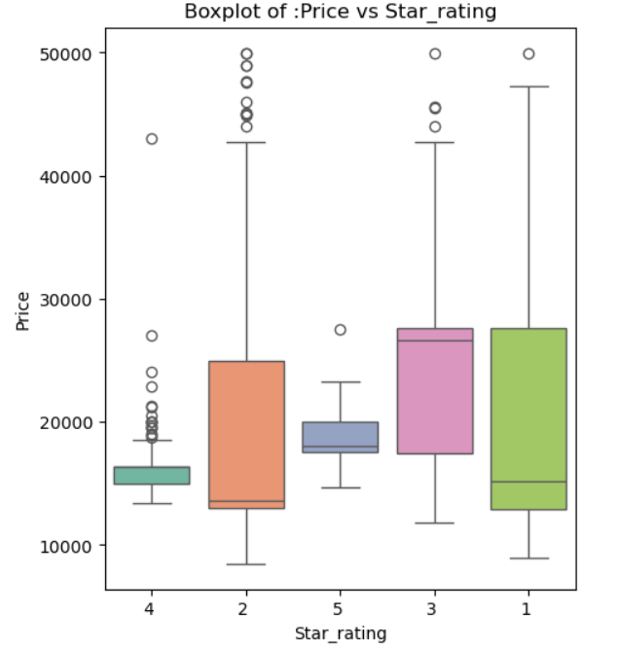
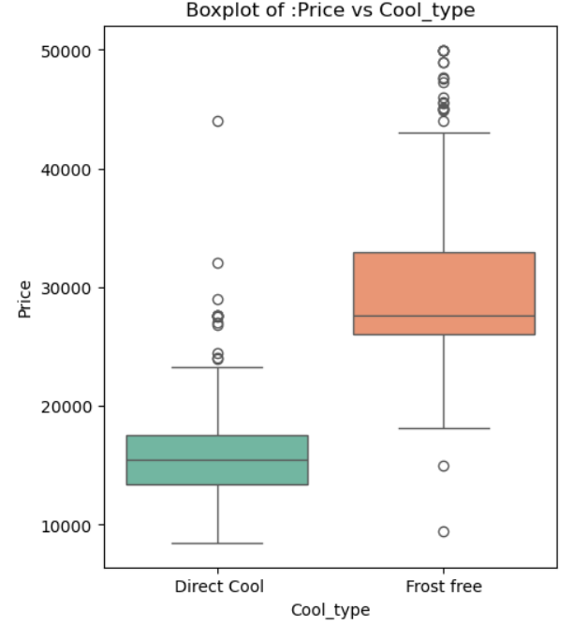
Bivariate plot of price on the basis of different categories
Observation: From the above plots we can see the variation in prices according to the features of refrigerators likewise their median price varies on the basis of their door type, star rating and cool type.

Slide 10
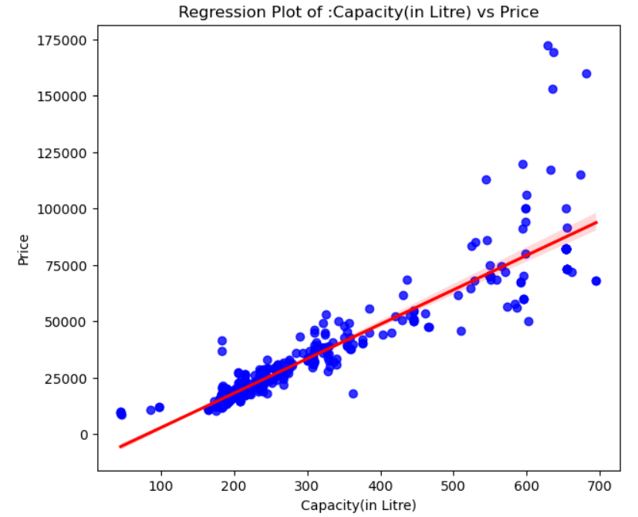
Bivariate plot on price on the basis of numerical columns
Observation: From the above regression plot we can say that refrigerator price varies as the capacity of refrigerators
Increases means the refrigerators with high capacity have high prices.

Slide 11
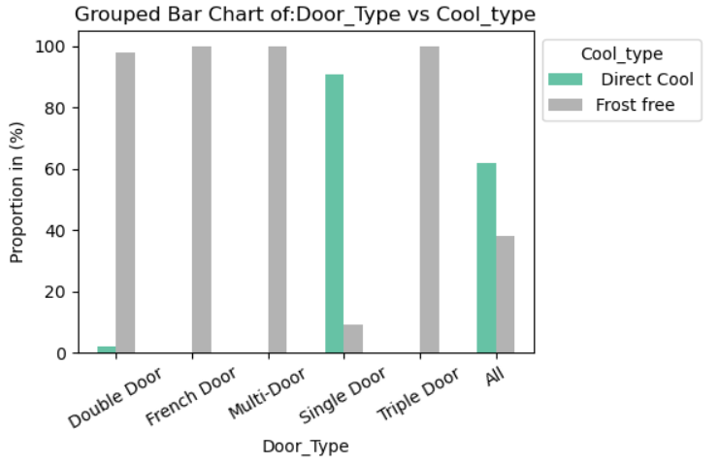
Cool type available on the basis of door
Observation: The above grouped bar chart shows us the availability of cool type in the refrigerators on the basis of variation in their doors type

Slide 12
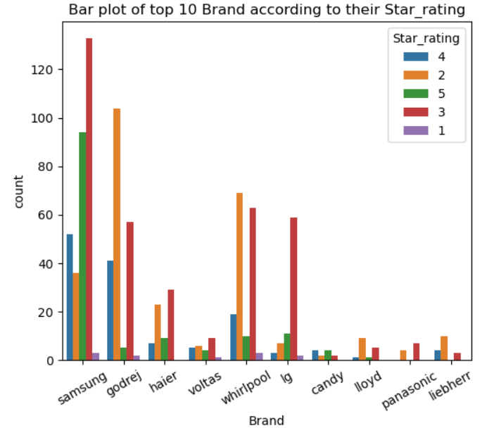
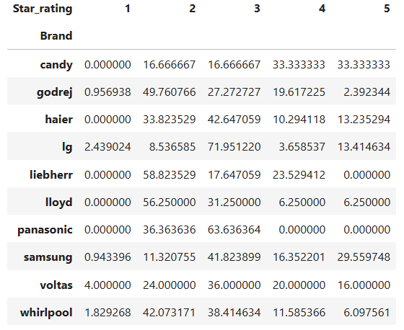
Bivariate plots on brands with different categories
Observation: From the above grouped bar plot we can see the availability of refrigerators from different brands based on their star_rating .

Slide 13
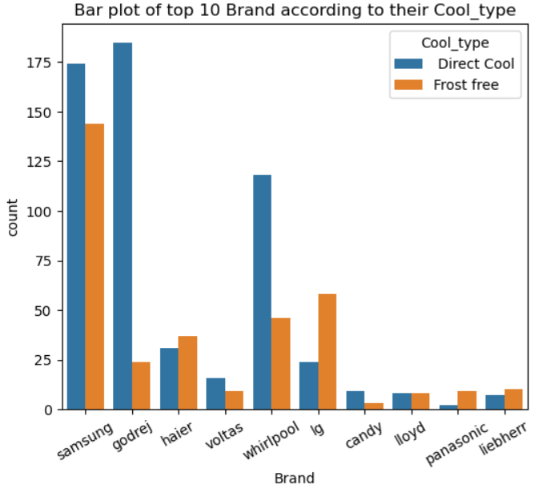
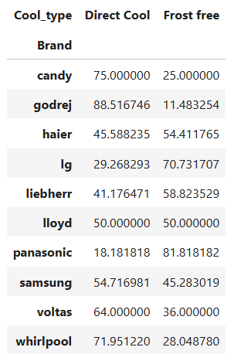
Observation: From the above grouped bar plot we can see the availability of refrigerators from different brands
Based on their cool type .

Slide 14
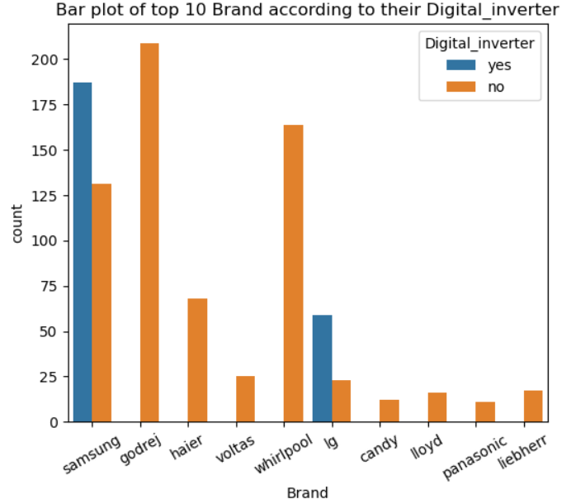
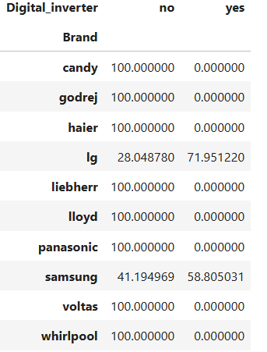
Observation: From the above grouped Bar plot we can see the availability of refrigerators from different brands
Based on the Digital inverter technology

Slide 15
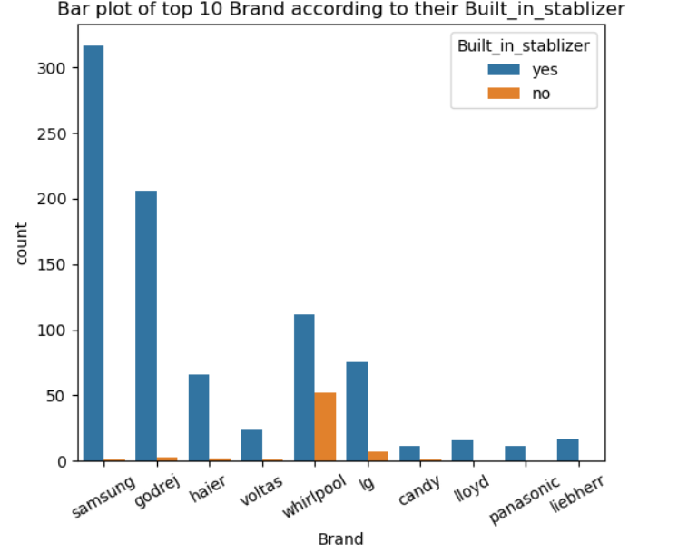
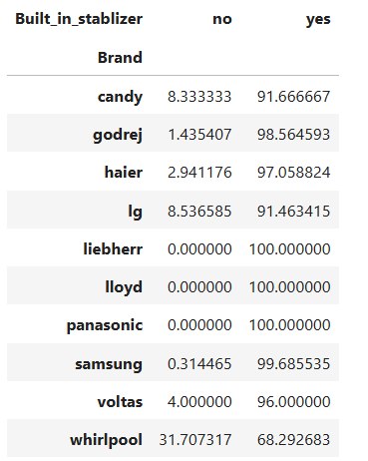
Observation: From the above grouped bar plot we can see the availability of the refrigerators from the different
Brands based on the Built in stablizer technology

Slide 16
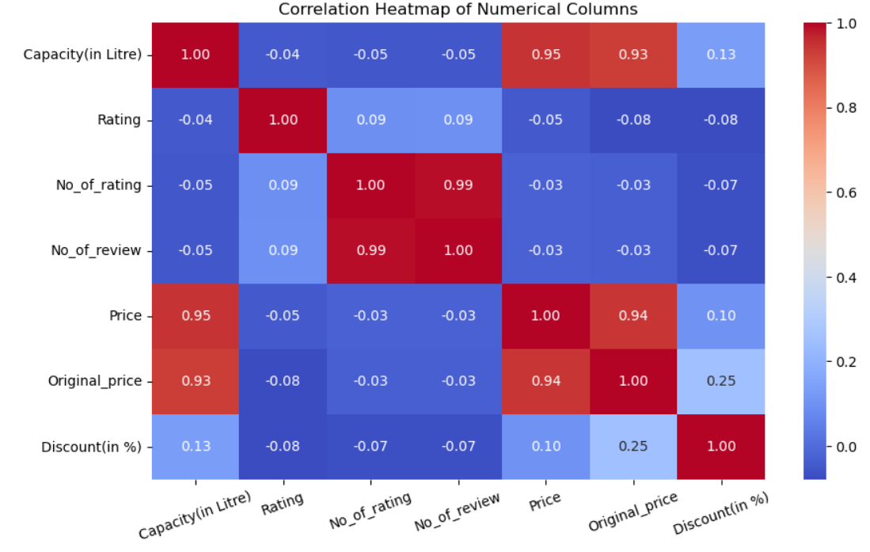
Heatmap on the numerical columns:
Observation: From the above heatmap we can see the relation between our numerical columns like there is a strong correlation between capacity and price , No_of_rating and No_of_review.

Slide 17
Conclusion:
Impact of Features & Capacity on Price:
1.There are price variation on the refrigerators which have more features it depends on their door type ,
Star rating , digital inverter.
2.Larger capacity refrigerators generally have a higher price range but there are mid range capacity refrigerators.
Brand Dominance:
1.Samsung , Godrej , Whirlpool and L.G are the dominant brands having various features and price range
2.These brands are well established , offering a wide range of models varies from budget friendly to premium categories.
Price Variation:
1.Premium brands and high-end models has an high price range whereas budget friendly refrigerators have less features as compared to premium refrigerators
Consumer Preference
1.Popular brands with good ratings tend to be in high demand and models with energy efficiency and smart features will
attract more buyers

Slide 18


Slide 19
Challenges faced while working with the project :
While working on the the Flipkart refrigerators web scraping project , I faced several challenges .first major
Issue was to check whether the available content is in html or loaded by javascript but in my web scraping project
The contents which i have scraped from the flipkart refrigerator data are stored in the html tags so I used
Beautiful Soup library for data extraction .second challenge was to scrape the data from multiple pages for it
I identified the change occurring in the url while shifting from page1 to 2 and framed my url according to that.
Additional things which keeps in mind while scraping the data from any url is that to keep headers along with
Our requests because every websites have anti scraping mechanism which used to block the requests.
When we extract the data from the url there is data inconsistency means there are so many null values ,varied
Structures so it needs data cleaning before our analysis.
Finally through this project , I learned how to handle with the real-world data and extraction problems which
Occurs while scraping any url.

Slide 20

THANK YOU

